Slide 1
Redefining the High School to College Transition in Illinois:
Framework and Recommendations
July 16, 2015

Slide 2
Overview
5-month planning process designed to improve the high school to postsecondary transition in Illinois
Process involved 9 regional teams, state education agencies, and national experts
Key outcomes:
Network of regions from across Illinois with impressive practices in place or emerging
Coherent framework for aligning high school and postsecondary education systems to support student success
Opportunities for state policy action and strategic investments to support and accelerate local efforts

Slide 3
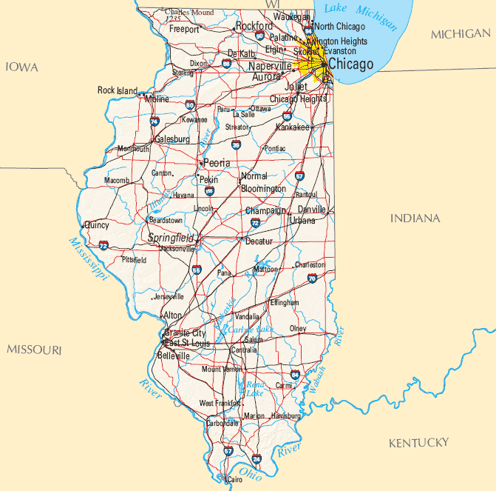
Educational Leaders From Across Illinois

Slide 4
Purpose of Framework
Guide for local action
State policy alignment
Framework for potential philanthropic investments
All of the elements of the framework should be addressed in successful high school to postsecondary transition systems

Slide 5
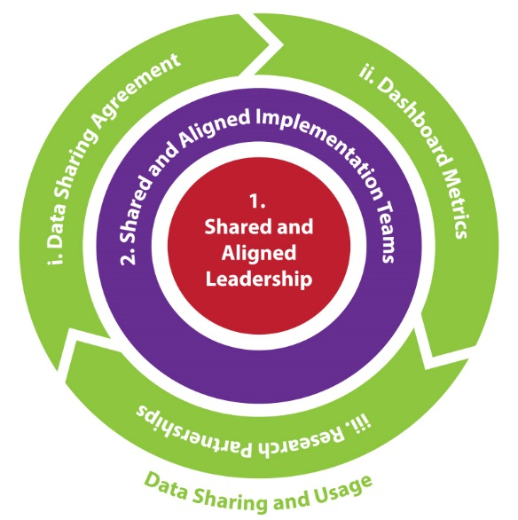

Slide 6
9th through 13+ Student-facing Systems
1. Core Academic Systems
2. Planning and Transition Supports
3. Accelerated Learning (“Speed-up”)
All of the elements of the framework should be addressed in successful high school to postsecondary transition systems

Slide 7
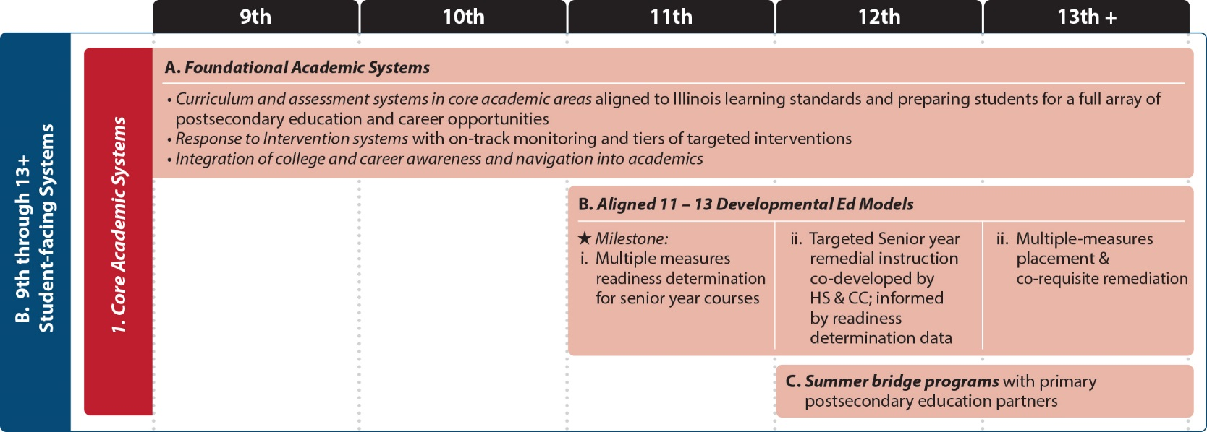
A. Foundational academic systems
B. Aligned 11-13 Developmental Ed Models
C. Summer Bridge Programs

Slide 8
A. Individualized Plan for Postsecondary Education, Careers, and Financial Aid
B. Outreach, Exposure, and Near-peer Mentoring Systems
C. Aligned Scholarship and Financial Aid Monitoring and Supports
D. Match and Fit, Proactive Advising Systems, and Progress Monitoring

Slide 9
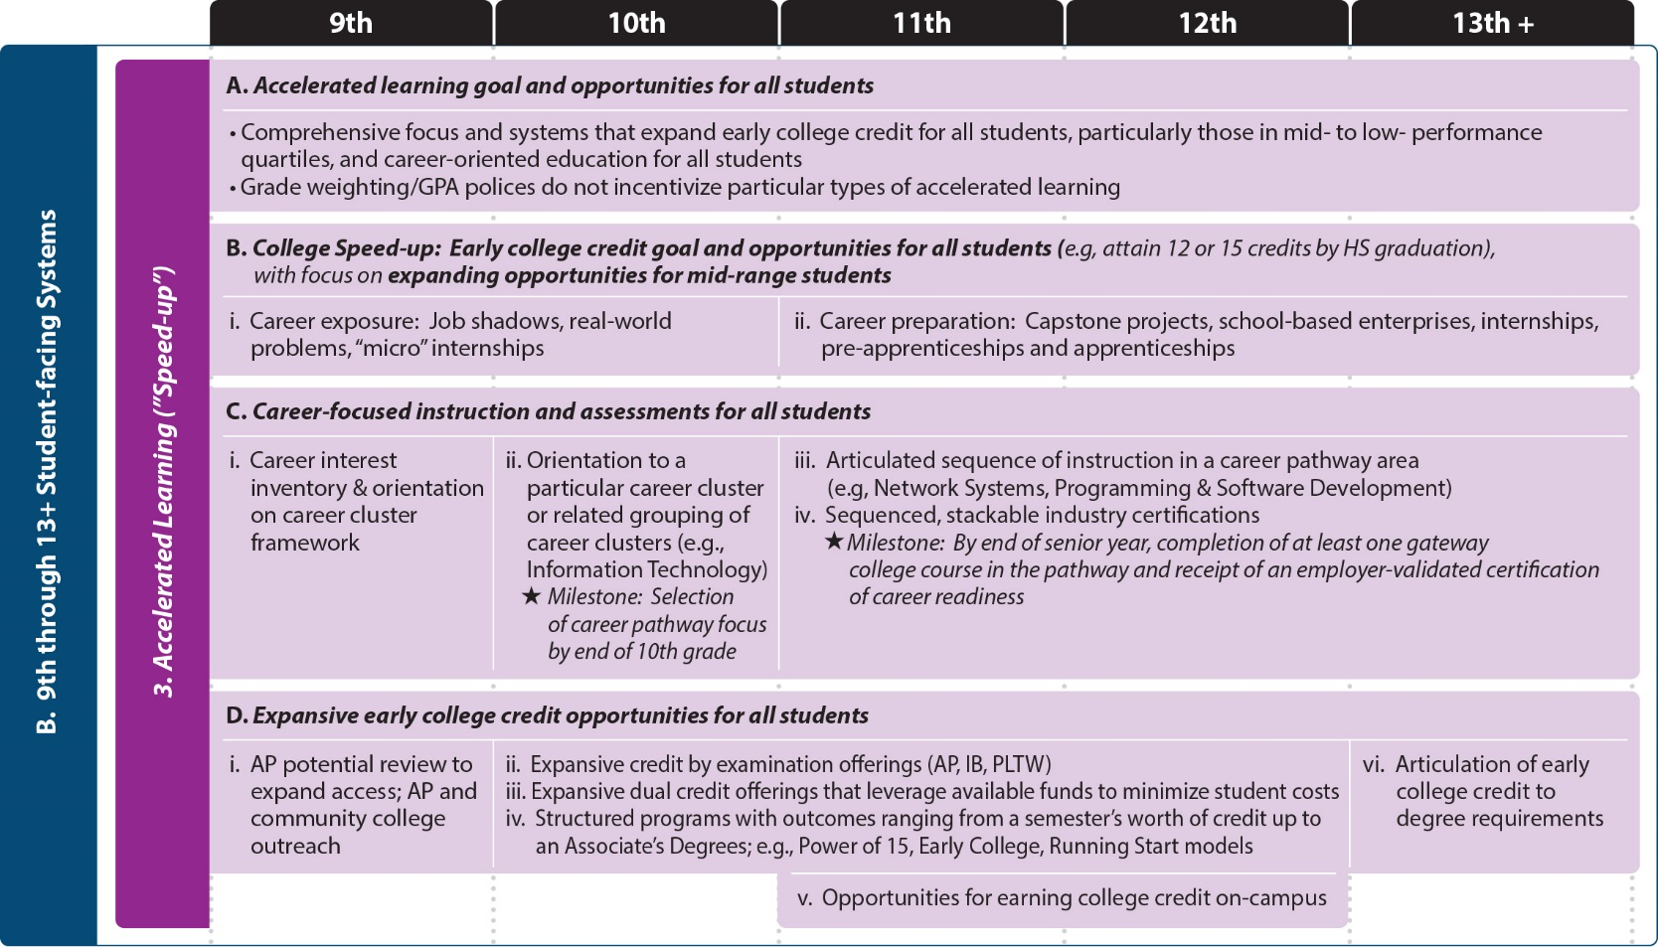
A. Accelerated Learning Goal and Opportunities for All Students
B. Continuum of Professional Learning for All Students
C. Career-focused Instruction and Assessments for All Students
D. Expansive Early College Credit Opportunities for All Students

Slide 10
Key Takeaways
This work requires a comprehensive approach
Planning and transition supports are needed alongside academic systems and early college coursework
You too can join this network!

Slide 11
ilhstocollege.org
Ben Boer
bboer@advanceillinois.org
Jon Furr
jfurr@niu.edu

